Slide 1
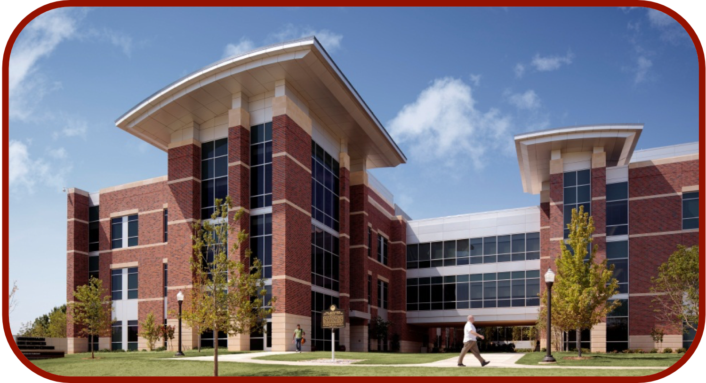
OmegaFold and Protein Structure Prediction
CCATS Group

Slide 2
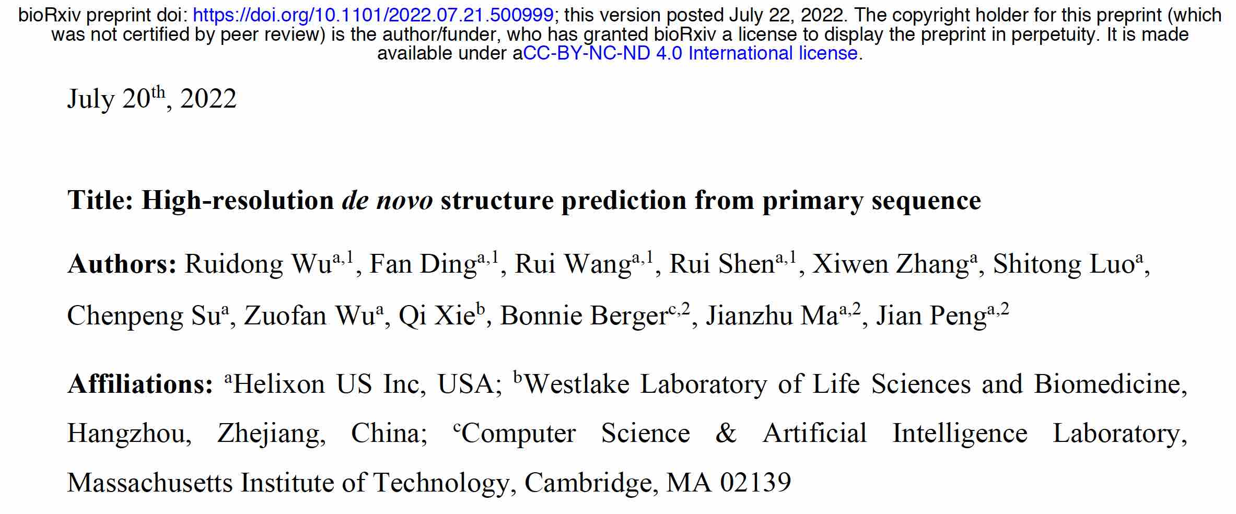
OmegaFold

Slide 3
How is OmegaFold Different?
Based on the understanding that
MSA does not always work, especially for fast-evolving antibodies, and orphan proteins.
Protein folds in a natural setting without exploiting evolutionary information.
OmegaFold predicts protein structure from a single primary sequence alone, i.e. alignment-free
It uses a pre-trained protein language model (PLM) to generate single- and pair-wise embeddings (i.e. representations)
training on a large collection of unaligned and unlabelled protein sequences
fed into Geoformer, which will further distill structural/physical pairwise relationships

Slide 4
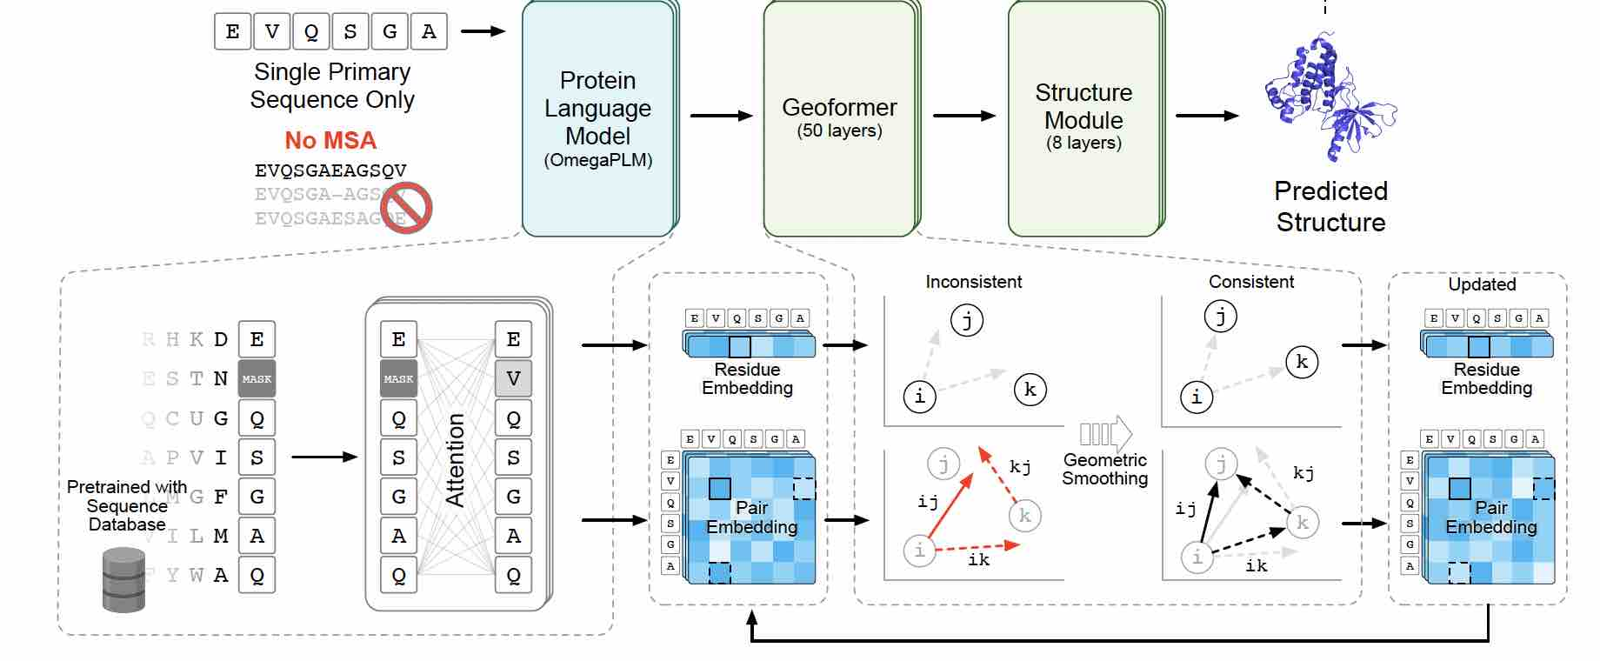
Workflow

Slide 5
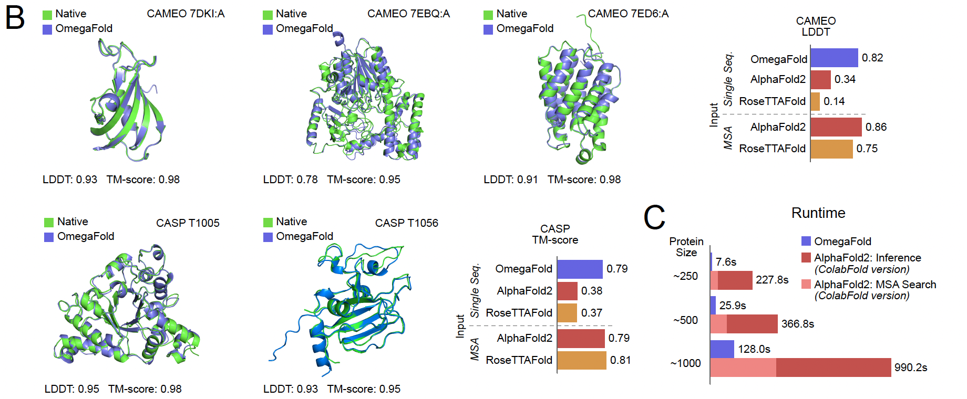
Prediction Results
For CASP and CAMEO proteins, OmegaFold is as accurate as AlphaFold2 and RoseTTAFold.
OmegaFold is much faster.

Slide 6
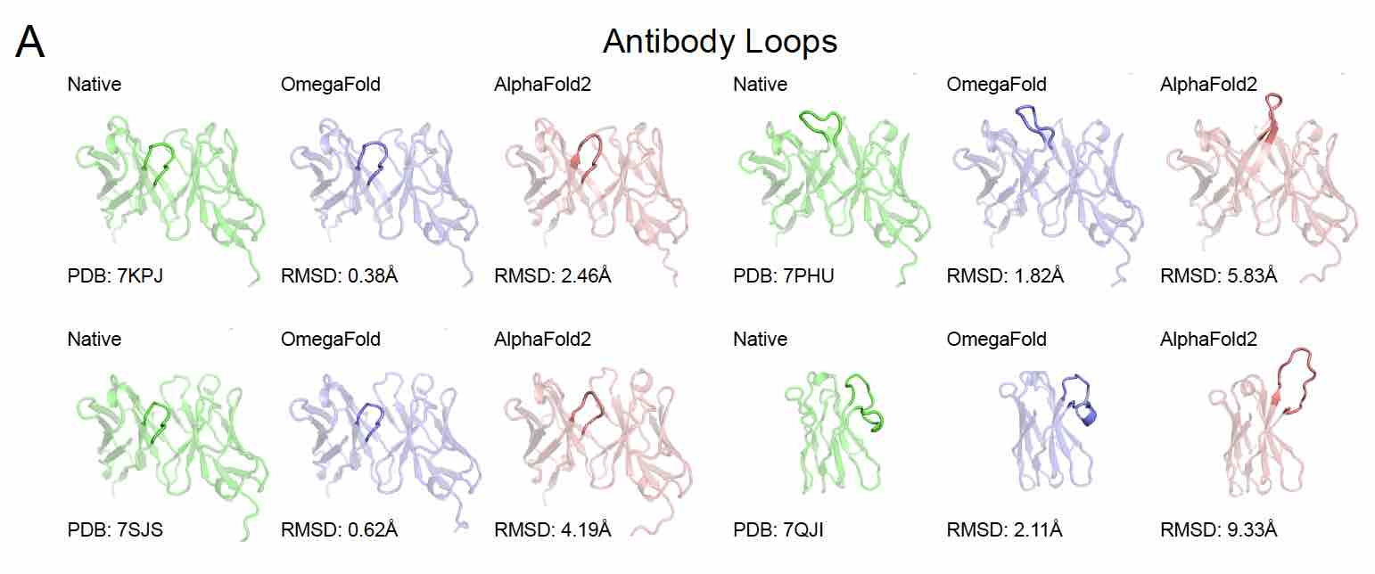
Prediction of Antibody Loops

Slide 7
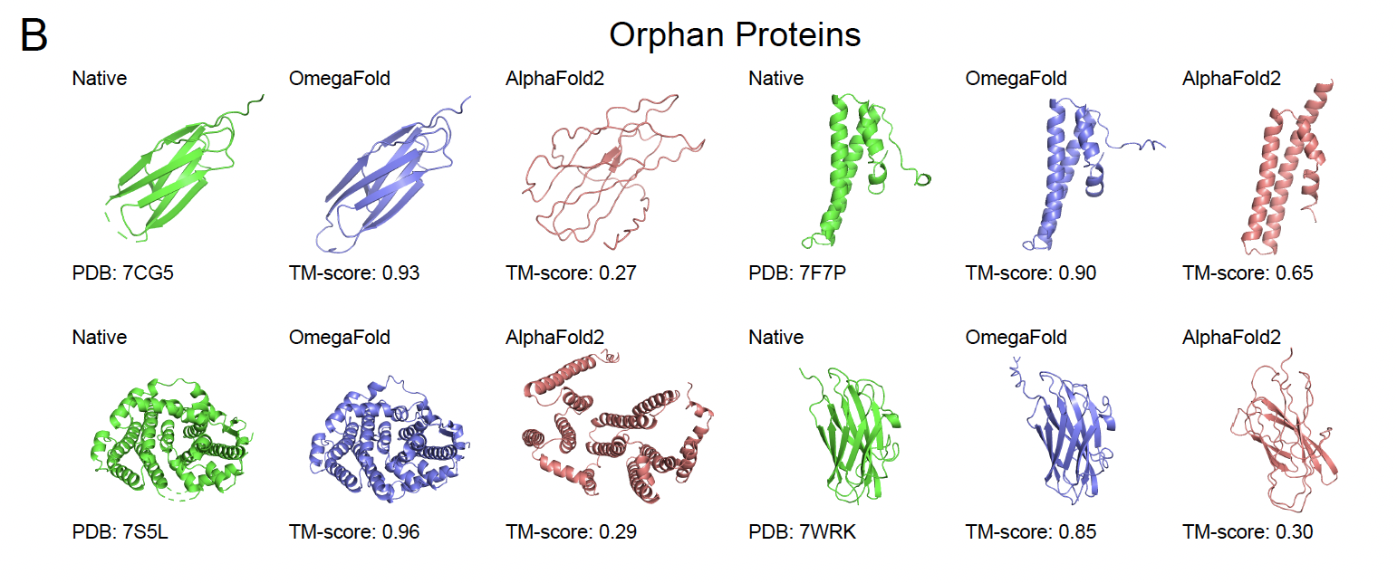
Prediction of Orphan Proteins

Slide 8
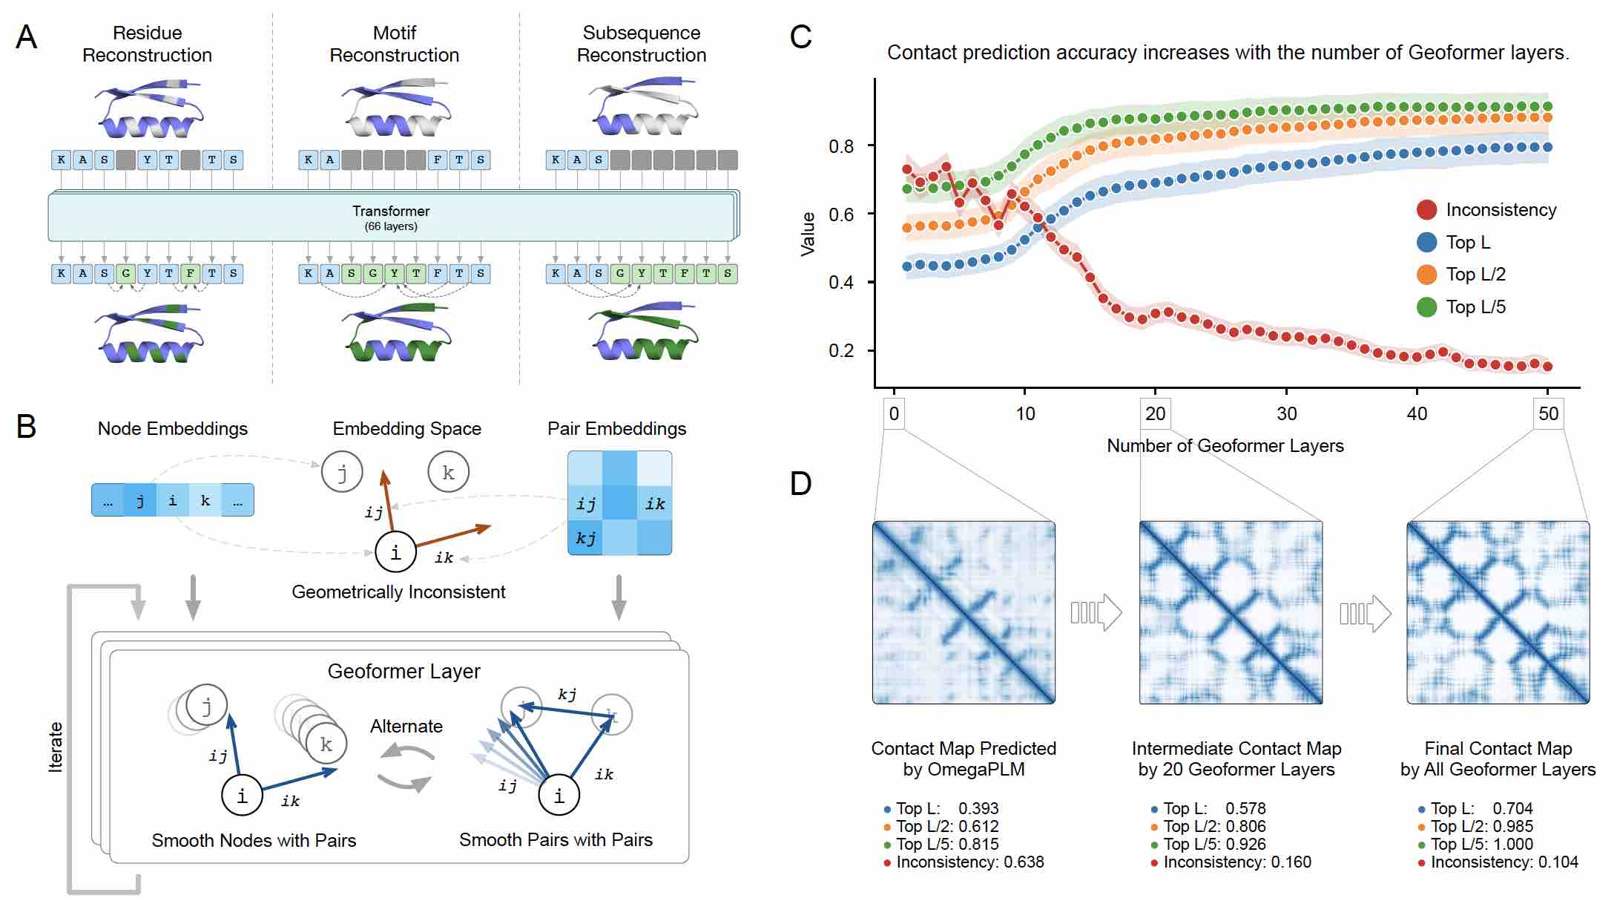
Geoformer

Slide 9
Installing OmegaFold
On OSCER, clone:
git clone https://github.com/HeliXonProtein/OmegaFold
Make new Conda environment:
conda create -n omegafold python=3.9
conda activate omegafold
The two types of GPUs on OSCER are NVIDIA K80m and A100
1 K80m on 1 node (c302, c307), 2 K80m on 1 node (c301), and 2 A100 on 1 node (c736)
All are not supported by > PyTorch 1.10 (Omegafold was written with Pytorch 1.12)
Thank you Nelson Liu for developing back support for old GPUs
https://github.com/nelson-liu/pytorch-manylinux-binaries/releases

Slide 10
Installing OmegaFold
Thank you Nelson Liu for developing back support for old GPUs
https://github.com/nelson-liu/pytorch-manylinux-binaries/releases
Remake requirements.txt > req_backsupport.txt (PyTorch 1.9.0)
In the omegafold conda environment
pip install -r req_backsupport.txt
Finally,
python ./setup.py install
To run: omegafold [input.fasta] [working directory]

Slide 11
Tutorial on OmegaFold
Copy the following directory to your home:
cp -r /home/van/MacroMol_Modelling_Tutorial/04_omegafold/ .
The folder is organized as follow:
04_omegafold
Results
Tutorial
bax
parDE
paparde.fasta
of_monomer.slurm

Slide 12
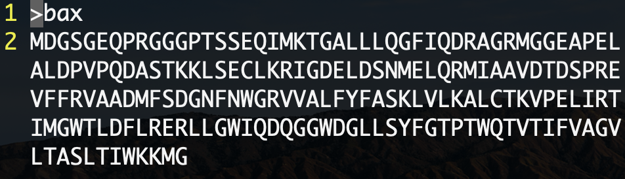
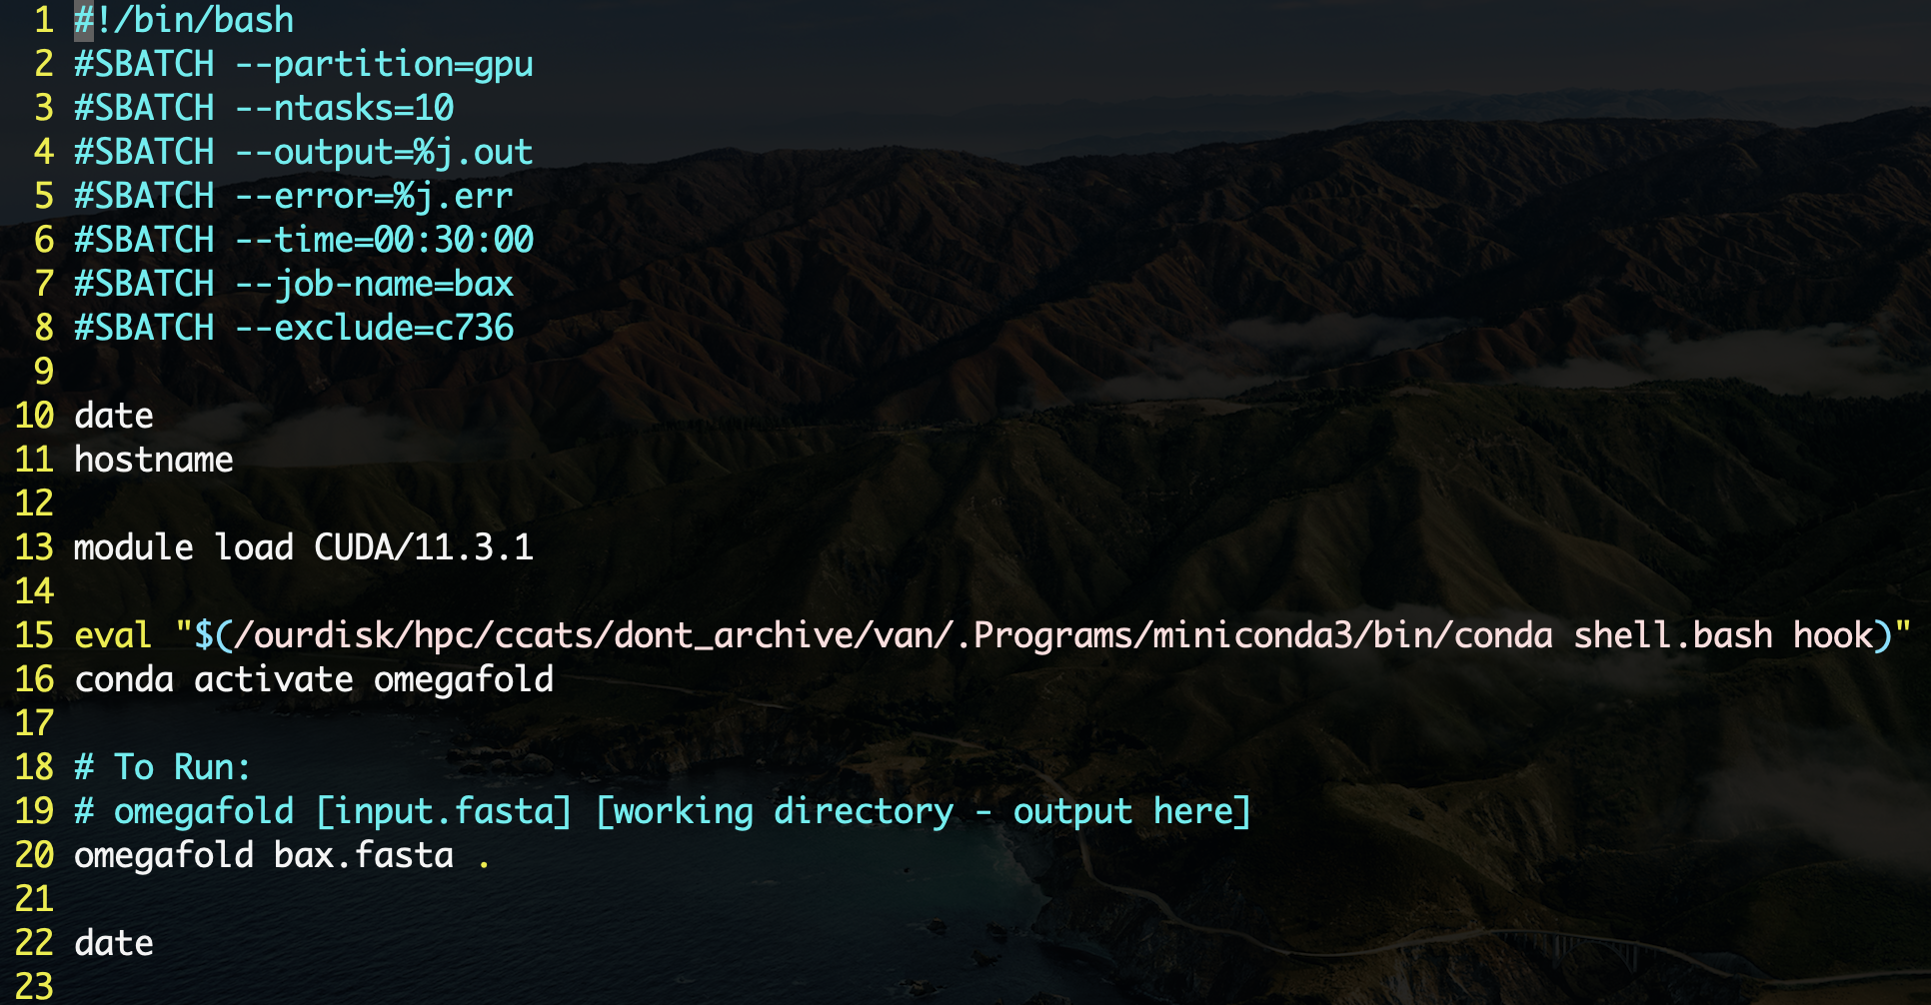

04_omegafold/Tutorial/bax
Bax.fasta
Amino acid sequence
of_monomer.slurm
SLURM script to run OmegaFold
To run:
sbatch of_monomer.slurm
SLURM Allocation requests
hostname = get name of node
Load CUDA
K80m (c307)
Wall Time: ~7 min
Prediction Time: ~172 sec
A100
Wall Time: ~5 min
Prediction Time: ~16 sec
Omegafold conda environment
Running OmegaFold

Slide 13
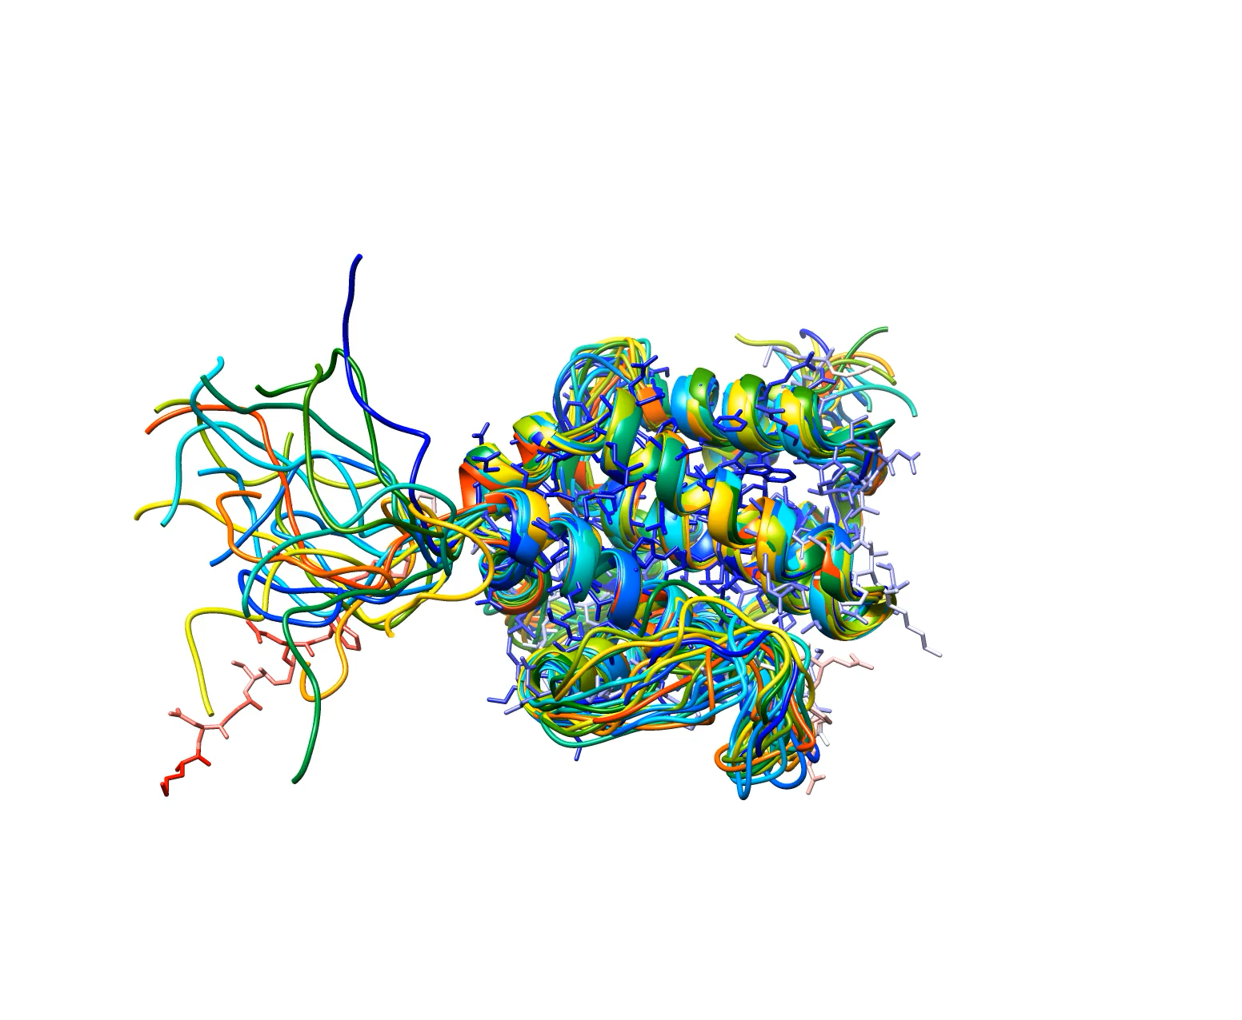
bax.pdb
PDB 1F16
OmegaFold

Slide 14
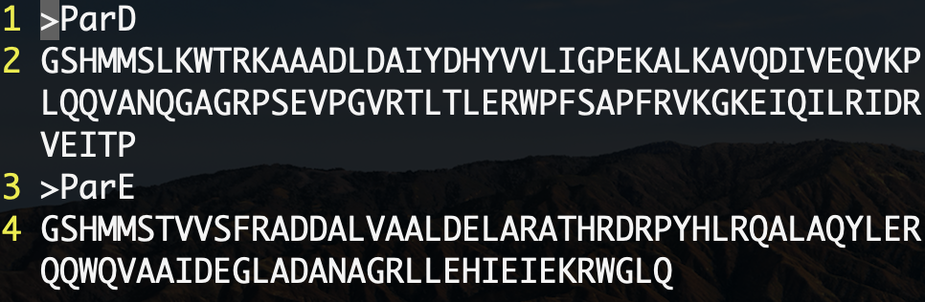
04_omegafold/Tutorial/parDE1
Currently, OmegaFold can only predict monomers
However, input can take in multiple sequences and predict them individually
paparde.fasta
Both ParD and ParE sequence
of_monomer.slurm
SLURM script to run OmegaFold
To run:
sbatch of_monomer.slurm
K80m (c307)
Wall Time: ~6 min
Prediction Time:
ParD ~39 sec
ParE ~50 sec

Slide 15
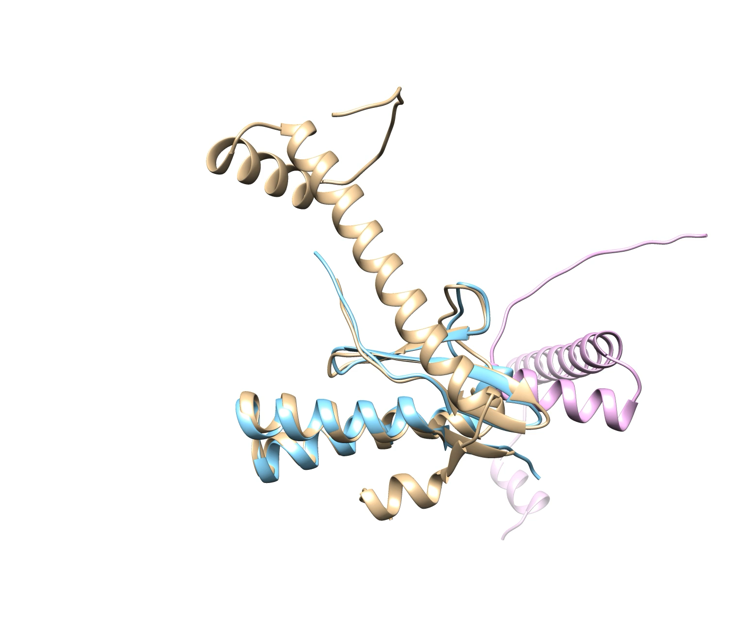
ParDE
PDB 6XRW
OmegaFold

Slide 16
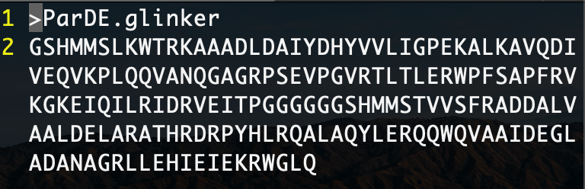
04_omegafold/Tutorial/parDE2
Lets modify the FASTA input so that we can predict the complex.
paparde.fasta
4 G are added to connect ParD -> ParE
of_monomer.slurm
SLURM script to run OmegaFold
To run:
sbatch of_monomer.slurm
K80m (c302)
Wall Time: ~10 min
Prediction Time: ~ 156 sec

Slide 17
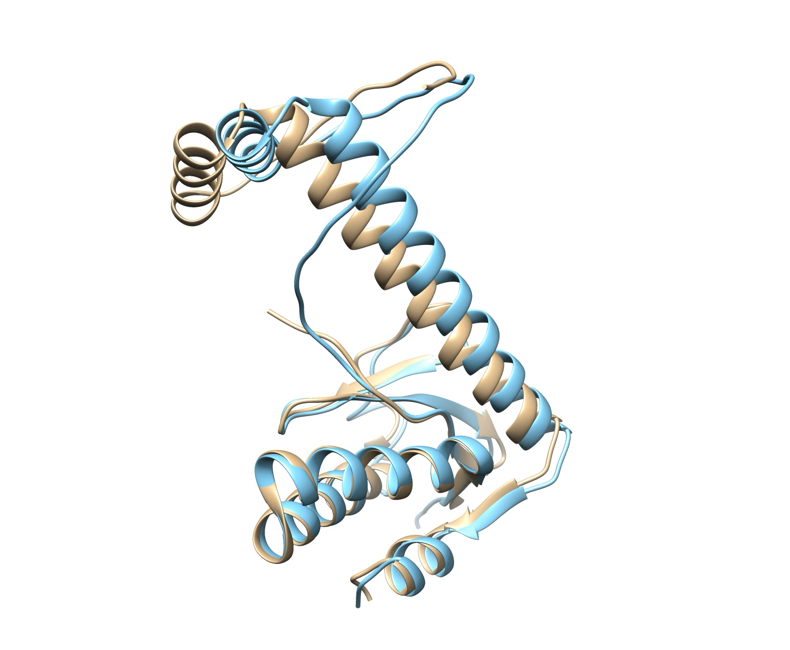
ParDE Complex
PDB 6XRW
OmegaFold

Slide 18
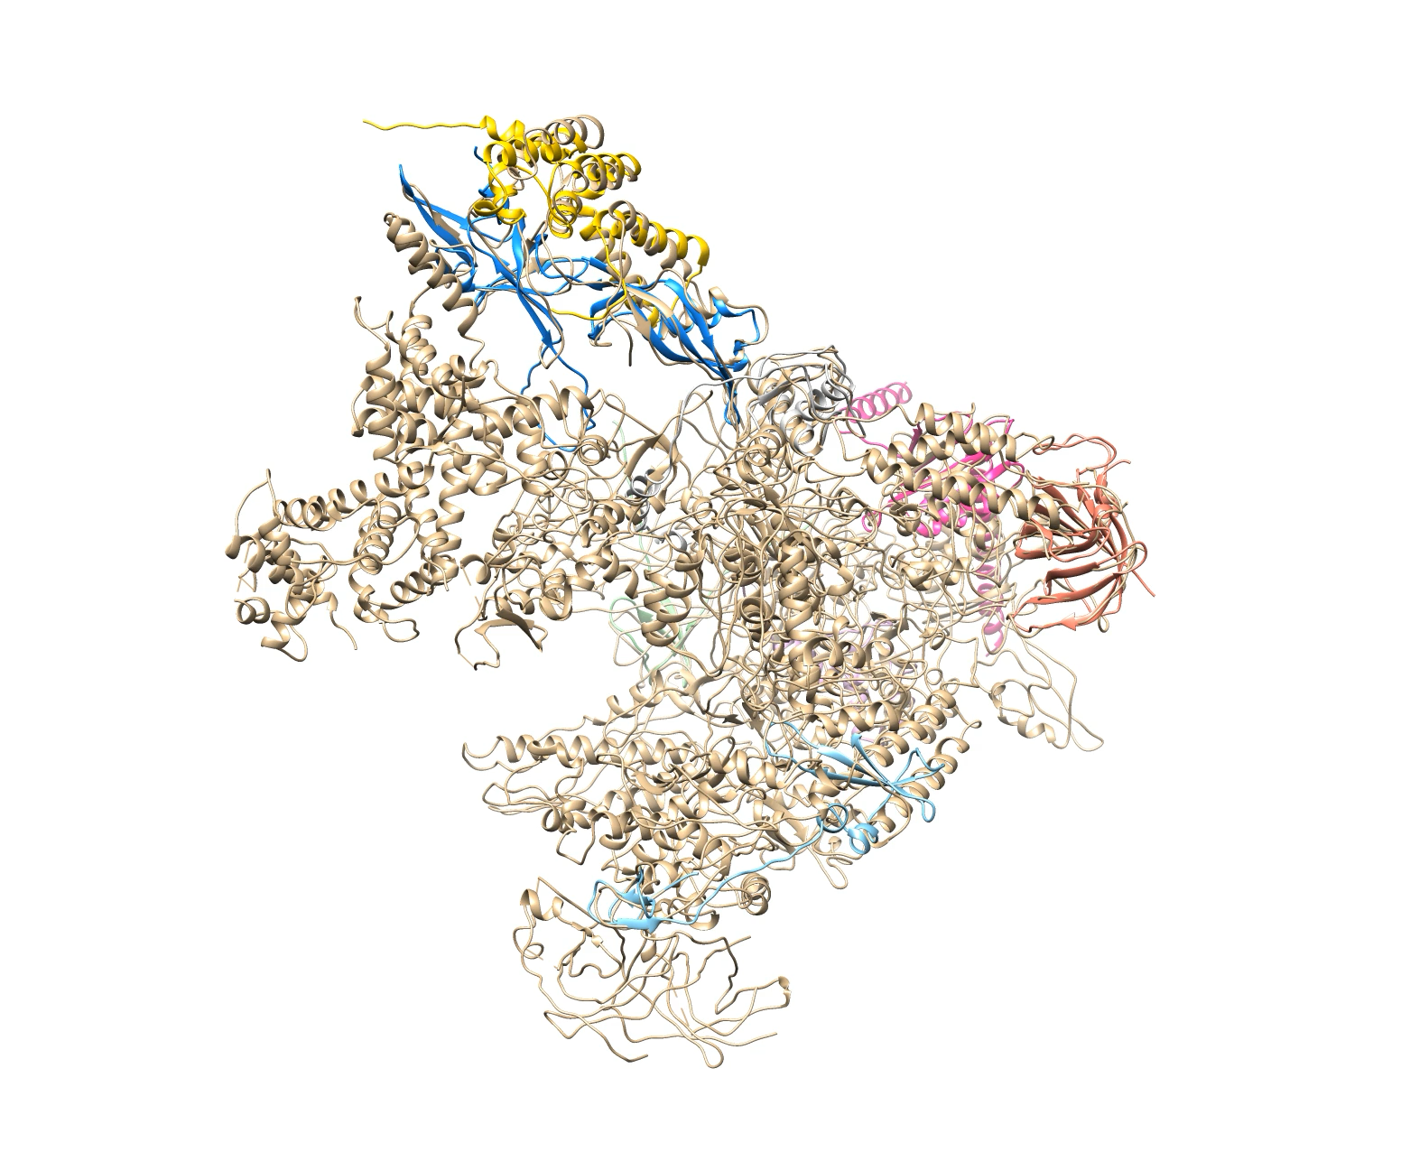
04_omegafold/Tutorial/pol3
Lets try human RNA Pol3 (~1300 residues)
PDB 7AST has Chain A-J (11)
pol3.fasta
Ran this on K80m and out of memory (5 Gb total)
PDB 7AST
OmegaFold

